Slide 1
Transitioning through Community College: A Model for Supporting Student Success
Jiffy Lansing, Northwestern University
Danielle McConnell, One Million Degrees

Slide 2
Overview
Community College Context
Student Challenges
One Million Degrees Supports
Why Identity?
Implementing Identity Framework in One Million Degrees’ Program Model
Notes:
1 minute for slides 2 - 4
Just a quick overview of the presentation:
First, I’ll provide some information about the community college landscape for context
Then, I’ll talk specifically about student challenges in community college
Then Danielle will give an overview of the One Million Degrees program model components
Then I’ll make the case for why it’s important to think about identity development when we think about supporting community college students and present an identity framework that OMD has incorporated into its programming
Finally, Danielle will highlight some specifics ways that OMD has incorporated the identity framework into their model.
After that, we are happy to take questions.

Slide 3
Community College Context
Community colleges serve a growing number of students and constitute a rapidly growing share of the postsecondary education landscape
Low-cost
Open-enrollment
Community-based
Multiple programs of study
Availability of supports
Notes:
1 minute

Slide 4
Challenges to Persistence
Student factors
Academic under-preparedness
Family and/or work obligations
Lack of “college knowledge”
Behavioral barriers
Institutional factors
Unclear or inconsistent information
Unaligned pathways
Limited resources for support services

Slide 5
One Million Degrees Multiple Supports
Financial Supports
Stipend of $1,000/year
Stipend contingent upon adequate progression through programming
Students can use the stipend in any way they choose
Academic Supports
Tutoring available to any who requests it
Tutoring required of those who need it (in remedial courses, new to college, or fall below the grade of C in any class)
Personal
Regular meetings and check-ins with designated program coordinator and volunteer coach
Connections to support services at the college or in the community
Professional
Clear expectations around standards of behavior and consequences for non-compliance
Experiential learning, coaching, and feedback on the development of professional behaviors
Notes:
Danielle – 1 minute

Slide 6
Why Focus on Identity?
Seeking social mobility takes more than just academic or technical skill development
Soft skills
Communication skills
Emotion management
Motivation
Decision-making skills
Anticipating potential obstacles
Meaning
Goals tied to purpose
Notes:
Jiffy – 1.5 minutes for slides 5 & 6
Now, there ain’t nothing’ wrong with all the supports that OMD is providing – they are based on research and best-practices. However, OMD is interested in long-term outcomes for their scholars. Community college students are faced with more than just some combination of support needs. They are individuals who are using education as a means to becoming social mobile. In that light, there are non-academic or technical skills that need to be developed that prepare them for new social worlds. These include: soft skills – what we think of as the types of transferrable skills that help individuals in any type of occupation or setting; motivation – this is not just the desire to get something but the ability to know how to make decisions day in and day out that help an individual work towards their goals and planning for obstacles that may get in their way; and meaning – that is, goals need to be tied to purpose if there are to be sustainable.

Slide 7
Identity Framework
Actor
Self-presentation
Agent
Goal Planning
Author
Interpreting present as integration of past & future
Decision-Making
* Inspired by and adapted from McAdam’s & Zapata-Geitl’s “Three Strands of Identity Development Across the Human Life Course: Reading Erikson in Full.” 2013 in K.C. McLean & M. Syed (Eds), The Oxford Handbook of Identity Development
Notes:
Drawing from human development theories, McAdams and Zapata-Geitl identified three streams of identity: self as social actor, self as motivated agent, and self as autobiographical author.
Briefly – the actor stream of identity is the first to develop, usually fairly early in the childhood years. It is the most superficial, and the most immediately responsive to environment. It is focused on how we present ourselves in interaction with others.
The agent stream of identity is the next to develop, usually during early adolescence. It involves incorporating a future-orientation, decision-making and commitment to pathways.
The third stage of identity development is authorship and this usually begins during adolescence. It’s when we start to develop stories about our lives that provide a sense of continuity over time and across contexts. It involves the integration of past events as we perceive them with future potential selves so that our present actions both feel authentic and enable change.
For community college students, students who are attending college in the communities in which they reside and who are striving to use education as a vehicle for social mobility, this identity framework can serve as the foundation for supporting community college students in a way that fosters the type of development that leads to success not only in community college but in work and life long-term.

Slide 8
Implementing Identity Framework in One Million Degrees
Actor
Agent
Author
Comprehensive scholar development model
Explicitly use program processes and roles to support scholar identity development
* Inspired by and adapted from McAdam’s & Zapata-Geitl’s “Three Strands of Identity Development Across the Human Life Course: Reading Erikson in Full.” 2013 in K.C. McLean & M. Syed (Eds), The Oxford Handbook of Identity Development
Notes:
Danielle – 6 minutes for slides 8 - 14

Slide 9
Implementing Identity Framework in One Million Degrees
PROCESSES
Accountability for professional presentation
Expectations for and practice with written and verbal communications
Participation in etiquette dinner
Develop elevator pitches and networking skills
Create polished resumes & LinkedIn profiles
Actor
Self-presentation
Agent
Author
* Inspired by and adapted from McAdam’s & Zapata-Geitl’s “Three Strands of Identity Development Across the Human Life Course: Reading Erikson in Full.” 2013 in K.C. McLean & M. Syed (Eds), The Oxford Handbook of Identity Development
Notes:
Drawing from human development theories, McAdams and Zapata-Geitl identified three streams of identity: self as social actor, self as motivated agent, and self as autobiographical author.
Briefly – the actor stream of identity is the first to develop, usually fairly early in the childhood years. It is the most superficial, and the most immediately responsive to environment. It is focused on how we present ourselves in interaction with others.
The agent stream of identity is the next to develop, usually during early adolescence. It involves incorporating a future-orientation, decision-making and commitment to pathways.
The third stage of identity development is authorship and this usually begins during adolescence. It’s when we start to develop stories about our lives that provide a sense of continuity over time and across contexts. It involves the integration of past events as we perceive them with future potential selves so that our present actions both feel authentic and enable change.
For community college students, students who are attending college in the communities in which they reside and who are striving to use education as a vehicle for social mobility, this identity framework can serve as the foundation for supporting community college students in a way that fosters the type of development that leads to success not only in community college but in work and life long-term.

Slide 10
Implementing Identity Framework in One Million Degrees
Actor
Self-presentation
Agent
Author
ROLES
Program Coordinator
Coach
OMD Scholar Community
Volunteers from the professional community
Tutors
* Inspired by and adapted from McAdam’s & Zapata-Geitl’s “Three Strands of Identity Development Across the Human Life Course: Reading Erikson in Full.” 2013 in K.C. McLean & M. Syed (Eds), The Oxford Handbook of Identity Development
Notes:
Drawing from human development theories, McAdams and Zapata-Geitl identified three streams of identity: self as social actor, self as motivated agent, and self as autobiographical author.
Briefly – the actor stream of identity is the first to develop, usually fairly early in the childhood years. It is the most superficial, and the most immediately responsive to environment. It is focused on how we present ourselves in interaction with others.
The agent stream of identity is the next to develop, usually during early adolescence. It involves incorporating a future-orientation, decision-making and commitment to pathways.
The third stage of identity development is authorship and this usually begins during adolescence. It’s when we start to develop stories about our lives that provide a sense of continuity over time and across contexts. It involves the integration of past events as we perceive them with future potential selves so that our present actions both feel authentic and enable change.
For community college students, students who are attending college in the communities in which they reside and who are striving to use education as a vehicle for social mobility, this identity framework can serve as the foundation for supporting community college students in a way that fosters the type of development that leads to success not only in community college but in work and life long-term.

Slide 11
Implementing Identity Framework in One Million Degrees
Actor
Agent
Planning
Author
PROCESSES
Support for career exploration
Information about educational pathways
Develop five-year plans
Develop SMART Goals
Self-evaluation and development of action steps using standardized rubric
Participate in discussions about barriers and strategies for navigating
* Inspired by and adapted from McAdam’s & Zapata-Geitl’s “Three Strands of Identity Development Across the Human Life Course: Reading Erikson in Full.” 2013 in K.C. McLean & M. Syed (Eds), The Oxford Handbook of Identity Development
Notes:
Drawing from human development theories, McAdams and Zapata-Geitl identified three streams of identity: self as social actor, self as motivated agent, and self as autobiographical author.
Briefly – the actor stream of identity is the first to develop, usually fairly early in the childhood years. It is the most superficial, and the most immediately responsive to environment. It is focused on how we present ourselves in interaction with others.
The agent stream of identity is the next to develop, usually during early adolescence. It involves incorporating a future-orientation, decision-making and commitment to pathways.
The third stage of identity development is authorship and this usually begins during adolescence. It’s when we start to develop stories about our lives that provide a sense of continuity over time and across contexts. It involves the integration of past events as we perceive them with future potential selves so that our present actions both feel authentic and enable change.
For community college students, students who are attending college in the communities in which they reside and who are striving to use education as a vehicle for social mobility, this identity framework can serve as the foundation for supporting community college students in a way that fosters the type of development that leads to success not only in community college but in work and life long-term.

Slide 12
Implementing Identity Framework in One Million Degrees
ROLES
Program Coordinator
Coach
OMD Scholar Community
Tutors
College Advisor
College Career Center
College Support Services
Actor
Agent
Planning
Author
* Inspired by and adapted from McAdam’s & Zapata-Geitl’s “Three Strands of Identity Development Across the Human Life Course: Reading Erikson in Full.” 2013 in K.C. McLean & M. Syed (Eds), The Oxford Handbook of Identity Development
Notes:
Drawing from human development theories, McAdams and Zapata-Geitl identified three streams of identity: self as social actor, self as motivated agent, and self as autobiographical author.
Briefly – the actor stream of identity is the first to develop, usually fairly early in the childhood years. It is the most superficial, and the most immediately responsive to environment. It is focused on how we present ourselves in interaction with others.
The agent stream of identity is the next to develop, usually during early adolescence. It involves incorporating a future-orientation, decision-making and commitment to pathways.
The third stage of identity development is authorship and this usually begins during adolescence. It’s when we start to develop stories about our lives that provide a sense of continuity over time and across contexts. It involves the integration of past events as we perceive them with future potential selves so that our present actions both feel authentic and enable change.
For community college students, students who are attending college in the communities in which they reside and who are striving to use education as a vehicle for social mobility, this identity framework can serve as the foundation for supporting community college students in a way that fosters the type of development that leads to success not only in community college but in work and life long-term.

Slide 13
Implementing Identity Framework in One Million Degrees
PROCESSES
Processing of life circumstances, motivations, and purpose for goals
Continuous reflection as part of workshops
Journaling and writing minute papers
Sharing personal stories and good news at workshops
Actor
Agent
Author
Meaning-Making
* Inspired by and adapted from McAdam’s & Zapata-Geitl’s “Three Strands of Identity Development Across the Human Life Course: Reading Erikson in Full.” 2013 in K.C. McLean & M. Syed (Eds), The Oxford Handbook of Identity Development
Notes:
Drawing from human development theories, McAdams and Zapata-Geitl identified three streams of identity: self as social actor, self as motivated agent, and self as autobiographical author.
Briefly – the actor stream of identity is the first to develop, usually fairly early in the childhood years. It is the most superficial, and the most immediately responsive to environment. It is focused on how we present ourselves in interaction with others.
The agent stream of identity is the next to develop, usually during early adolescence. It involves incorporating a future-orientation, decision-making and commitment to pathways.
The third stage of identity development is authorship and this usually begins during adolescence. It’s when we start to develop stories about our lives that provide a sense of continuity over time and across contexts. It involves the integration of past events as we perceive them with future potential selves so that our present actions both feel authentic and enable change.
For community college students, students who are attending college in the communities in which they reside and who are striving to use education as a vehicle for social mobility, this identity framework can serve as the foundation for supporting community college students in a way that fosters the type of development that leads to success not only in community college but in work and life long-term.

Slide 14
Implementing Identity Framework in One Million Degrees
Actor
Agent
Author
Meaning-Making
ROLES
Coach
Program Coordinator
OMD Scholar Community
Scholar family and supportive network
* Inspired by and adapted from McAdam’s & Zapata-Geitl’s “Three Strands of Identity Development Across the Human Life Course: Reading Erikson in Full.” 2013 in K.C. McLean & M. Syed (Eds), The Oxford Handbook of Identity Development
Notes:
Drawing from human development theories, McAdams and Zapata-Geitl identified three streams of identity: self as social actor, self as motivated agent, and self as autobiographical author.
Briefly – the actor stream of identity is the first to develop, usually fairly early in the childhood years. It is the most superficial, and the most immediately responsive to environment. It is focused on how we present ourselves in interaction with others.
The agent stream of identity is the next to develop, usually during early adolescence. It involves incorporating a future-orientation, decision-making and commitment to pathways.
The third stage of identity development is authorship and this usually begins during adolescence. It’s when we start to develop stories about our lives that provide a sense of continuity over time and across contexts. It involves the integration of past events as we perceive them with future potential selves so that our present actions both feel authentic and enable change.
For community college students, students who are attending college in the communities in which they reside and who are striving to use education as a vehicle for social mobility, this identity framework can serve as the foundation for supporting community college students in a way that fosters the type of development that leads to success not only in community college but in work and life long-term.

Slide 15
Questions & Comments
jiffy@u.northwestern.edu
dmcconnell@onemilliondegrees.org

Slide 16
Additional Slides on OMD

Slide 17
OMD Program Coordinator
Program Coordinators are the frontline of the organization, acting as “intrusive advisors,” mentors, and caseload managers, closely monitoring the development and progress of each scholar towards graduation, personal, and professional goals.
Weekly or bi-weekly contact to make sure that students take full advantage of the OMD Program and campus resources; coach them through decision-making, challenges, and barriers; and check-in on their overall development and progress
Study challenges
Academic barriers
Application or job prep
Personal concerns
Successes and celebrations
Collection of qualitative and quantitative data to help inform the types of interventions and contact level (hi or low touch)
Evaluation of Scholar: rubric used to assess student’s development inn a number of domains including academic, behavioral, attitudinal, and proactivity
Facilitation of monthly workshops focused on professional development, identity development, financial literacy, and leadership.
Notes:
DM (3 minutes)
Hi and low touch is determined by risk indicators
Ask very specific questions for weekly
Qualitative: how are tutoring sessions, are you taking advantage of on campus resources, where are you struggling in class?
Quantitative: grades, financial aid information, number of people they support

Slide 18
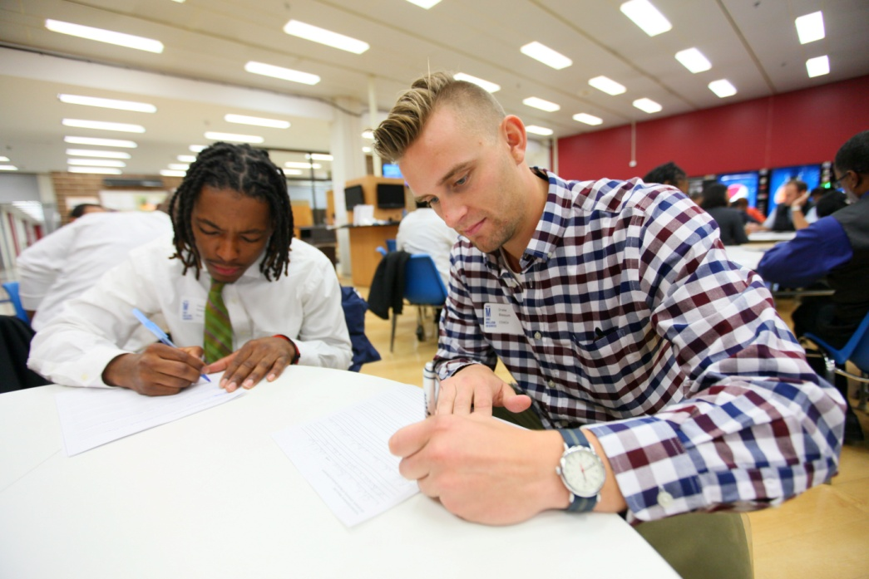
Other Key Support Volunteers and Staff
Coaches
Tutors
Supportive professionals
Guide scholars with resume development, goal setting, networking, application or job prep
Commitment & communication is key!
Private tutoring is available for all scholars
Tutoring is required for students new to college, in developmental courses, or who have previously struggled academically.
Notes:
1 minute
Re-emphasize the direct people in your corner
2016-2017
No edits thus far

Slide 19
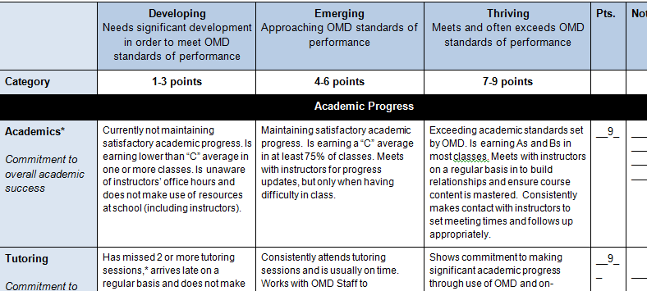
Do Your PART Rubric and Scholar Risk Indicators
Risk Indicators
ACADEMICS | PERSONAL
Remedial courses | Gain or loss of employment
Poor grades | Housing displacement
Struggling Academically | Pregnancy
2.0 G.P.A (SAP Hold Risk) | Family Obligations and Responsibilities
Class Attendance: Withdrawals | Unstable or inconsistent childcare
Class Attendance: Not attending Classes | Traumatic life event
PROGRAMMING | Reduction in financial aid
OMD event attendance | Health challenges
Communications
Status Standing
Notes:
KD 5 minutes
Office hours are scheduled on campus-very impactful data collection points/updates. Obtain and review changes in academic plans, financial aid award packages, academic barriers. We also encourage scholars to utilize resources on campus like the wellness center (support mental health concerns, and connects students to housing, healthcare) We also collect college transfer status and updates on current jobs.
Interactions and Data Collection Inform Interventions and Supports
These calls are documented in an excel document template and later uploaded to salesforce to a scholars contact record information.
Determining High/Low Touch Interventions
Understand the implications of risk factors on graduation plans
Academic supports
Collaboration with campus stakeholders
Referring resources (social services, health care services)
Internship/job opportunities
Scholarship information
Professional opportunities
Connecting to networks

Slide 20
An Extraordinary Commitment to Success
OMD Scholars are determined, resilient, and visionary. Whether they are young people entering college for the first time or returning adults determined to complete their degrees, they are juggling numerous responsibilities and challenges, while working hard to create bright futures for themselves, their families, and their communities.
70%
84%
$50,000
2.5 years
OMD Graduation Rate
compared to the 20% graduation rate of traditional community college students in Illinois.
OMD Retention Rate
while half of the general community college population will dropout before the end of the second year.
Average Household Income
after graduation reported by OMD alumni compared to $32,000—the average across all associate’s degree holders.
Time to Graduate
OMD Scholars graduate in less than half the time of a traditional community college student.
Exponential
Impact
As the first in their families to go to college, the success of an OMD Scholar has profound, positive implications for their communities and future generations.

Slide 21
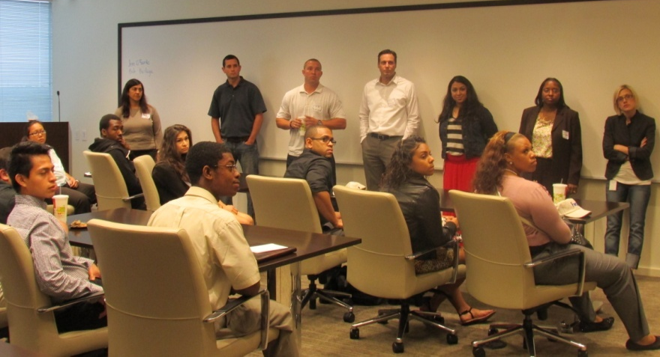
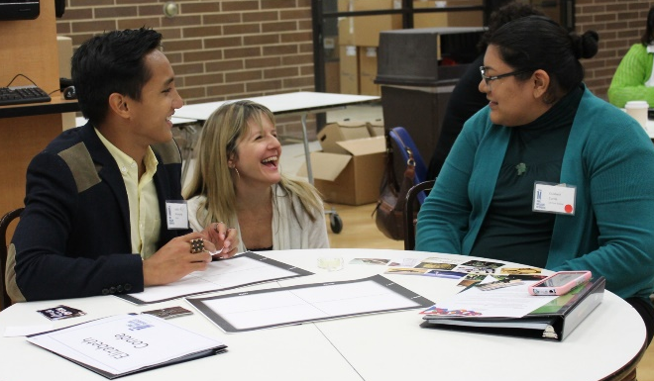
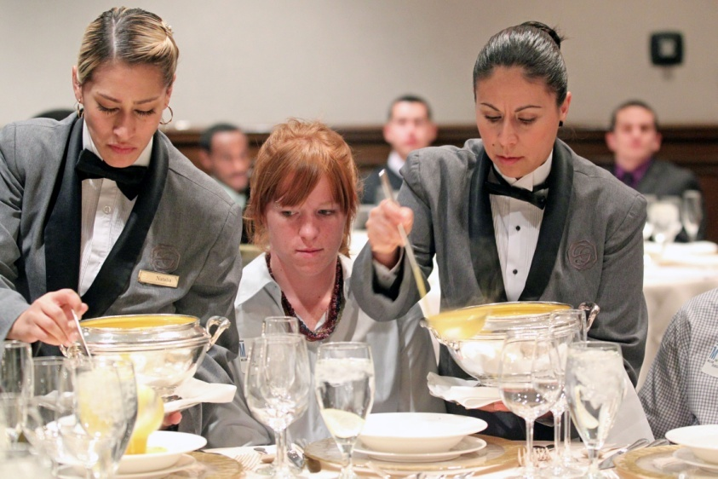
Building Confidence and Skills for Tomorrow’s Leaders
OMD Scholars pursue degrees in diverse fields. Most are first in their families to attend college. OMD helps them prepare for career trajectories with increasing levels of challenge and responsibility, and help them discover and develop new possibilities, new aspirations and a new belief in their own growing abilities.
Scholars build relationships with peers and coaches while practicing key skills needed for success in college and work during monthly Scholar Development Sessions
Wisdom from the Workplace – program event series offers OMD Scholars with the valuable opportunity to visit and interact with our corporate partners.
'It's Who You Know' Speed Networking supports Scholar communication skills through speed networking sessions and a reception with leaders in diverse professional fields.
Scholars learn the nuances of business dinner etiquette and social networking at the annual One Million Degrees Etiquette Dinner.
Notes:
Add SDS picture?

Slide 22
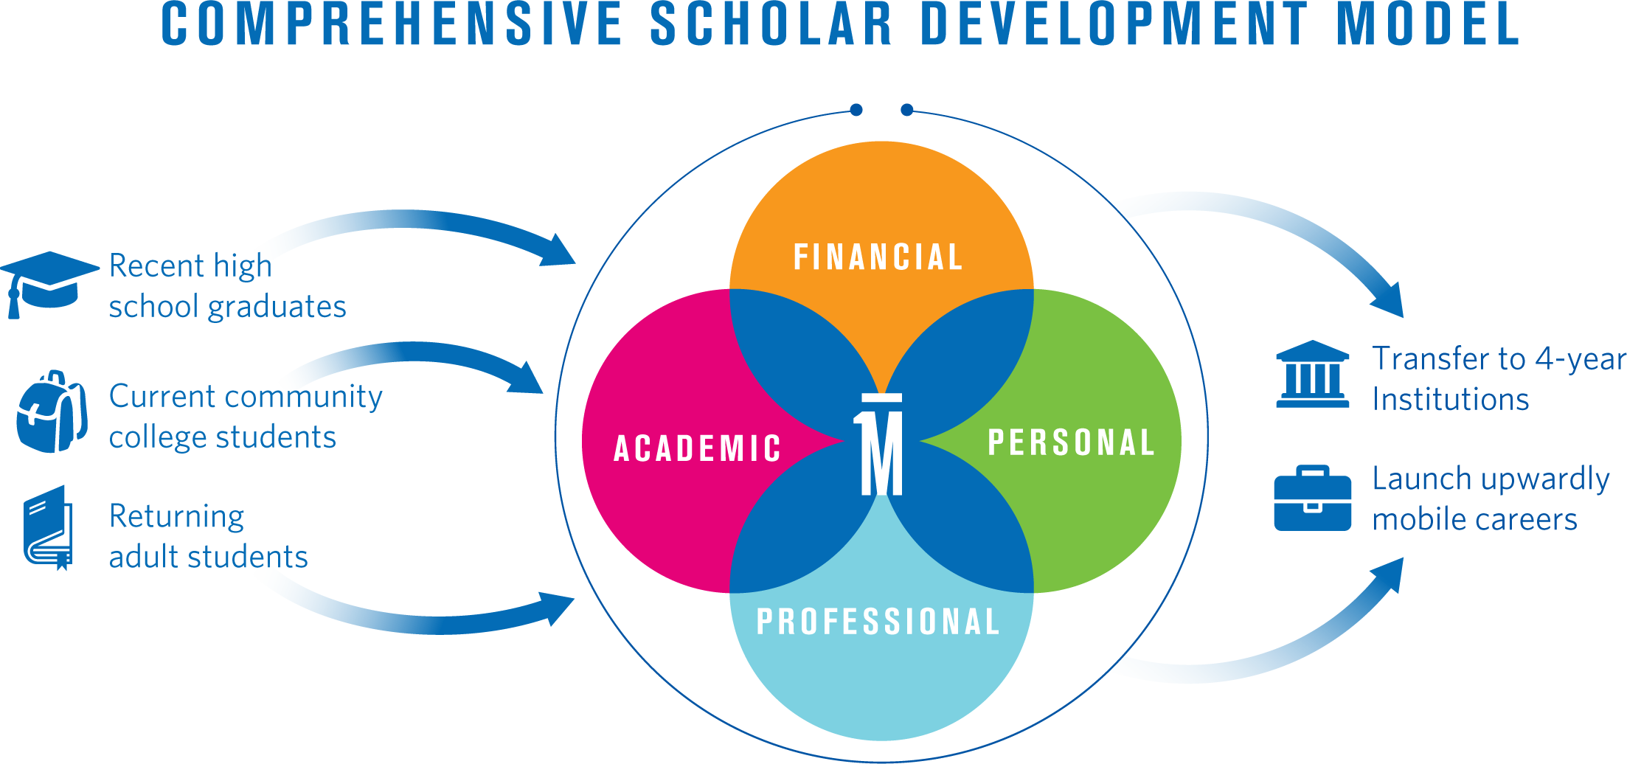
OMD: Multiple Supports Model
Notes:
2 minutes

